Slide 1
DATA ANALYTICS PROJECT REPORT • PORTFOLIO PRESENTATION
Telecom Customer Churn Analysis
End-to-End Diagnostic of 2,000 Customer Accounts Engineered with Microsoft Excel, Power BI Dashboarding, and AI Analytics
Excel (Data Cleaning & Pivots)
Power BI (DAX & Visuals)
AI Tools (Root Cause Insights)
Project by
Gaurav Patkotwar

Slide 2

Table of Contents
• Executive Summary
• Introduction
• Methodology & Data Pipeline
• Results & Analytical Findings
• Key Performance Indicators (KPI Scorecards)
• Data Visualizations & Charts
• Interactive BI Dashboard
• Discussion & Strategic Implications
• Core Findings & Root Causes
• Actionable Recommendations / Business Strategy
• Conclusion & Business Impact

Slide 3
Executive Summary
Total Customers
Overall Churn Rate
Active Subscribers
Monthly Revenue at Risk
2,000
19.7%
1,606
$26.8K
100% Unique Accounts
394 Churned Accounts
80.3% Retention Rate
$321.7K Annualized Risk

Slide 4
PROJECT BACKGROUND
Introduction & Business Problem
1. The Business Challenge
2. Root-Cause Discovery
3. Data-Driven Retention
Customer attrition directly reduces predictable Monthly Recurring Revenue (MRR) and escalates Customer Acquisition Cost (CAC).
Identify whether churn is driven by contract duration, payment method friction, or service quality gaps.
Build Power BI interactive Dashboard to target high-risk accounts and protect $26.8K monthly revenue.

Slide 5
WORKFLOW & IMPLEMENTATION
Methodology & Data Pipeline
1. Microsoft Excel
2. Power BI Desktop
3. AI Analytics Tools
• Cleaned 2,000 customer records and verified zero duplicates.
• Created TenureGroups bins (0–12 Mo, 13–24 Mo, etc.).
• Built 4 multi-dimensional Pivot Tables & KPI Dashboard.
• DAX Measures for Churn %, Revenue at Risk, and Cohorts.
• Interactive dashboard with slicers and cross-filtering.
.• Generated DAX syntax
• Synthesized executive business retention recommendations.

Slide 6
Results & Analytical Findings

Slide 7
Key Performance Indicators (KPI Scorecards)

Slide 8
Data Visualizations & Charts
Customer Churn by Contract Type
Month-to-Month Contracts
31.8% Churn
Primary Attrition Zone
One-Year Contracts
11.2% Churn
Month-to-month subscribers churn at 10x the rate of 2-year contracted users.
Two-Year Contracts
3.1% Churn
Long-Term Contract Safety
Two-year contracts provide a 96.9% retention guarantee, establishing stable MRR.
Finding: Month-to-month contracts drive over 80% of total churn volume (315+ of 394 lost accounts).

Slide 9

Payment Method Churn & Friction
Electronic Check (Manual Billing)
33.6% Churn
High payment friction, bill surprises, and manual payment delays drive cancellations.
Auto-Pay (Bank Transfer & Credit Card)
14.2% Churn
Recurring automated deduction cuts customer churn likelihood by 58%.
Electronic Check (33.6%)
Mailed Check (18.2%)
Bank Transfer (14.5%)
Credit Card (13.9%)

Slide 10
Internet Service & Tech Support Impact
Without Add-On
With Add-On
30.8%
28.4%
High Spend Vulnerability
27.9%
Fiber Optic subscribers pay higher monthly charges; unassisted glitches trigger quick churn.
14.6%
11.8%
11.2%
Protective Stickiness
Bundling Tech Support and Online Security drops customer churn to just 11.8%.
Fiber vs DSL
Tech Support
Online Security
Fiber Optic users have higher spend but churn 2.1x faster when unassisted by Tech Support.

Slide 11

Customer Churn by Tenure
34.2%
Year 1 Attrition Rate (Highest Risk Cohort in First 12 Months)
92.8%
Long-Tenure Retention Rate (4+ Years Established Loyalty)
0 - 12 Mo (34.2%)
13 - 24 Mo (20.5%)
25 - 48 Mo (14.1%)
49+ Mo (7.2%)

Slide 12
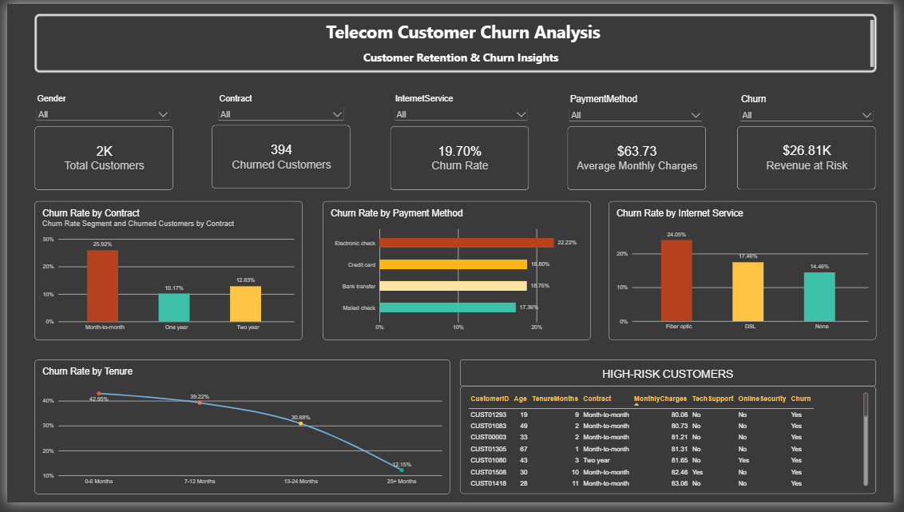
Interactive Power BI Dashboard

Slide 13
Discussion & Strategic Implications
Core Findings & Root Causes
31.8%
33.6%
34.2%
Month-to-Month
Electronic Check
First-Year Risk
Represents 80%+ of total churned volume; lack of long-term commitment causes rapid exits.
Highest payment churn rate; converting to auto-pay cuts cancellation probability by 58%.
The first 12 months are the most critical window; tenure past 48 months drops churn to 7.2%.

Slide 14
Actionable Recommendations / Business Strategy
01
02
03
04
Contract Migration
Auto-Pay Incentives
Support Bundles
First-Year Journey
Offer an $8 monthly discount on the average $63.73 bill to migrate high-risk month-to-month users into 1-year plans.
Provide $5 statement credit to convert Electronic Check users to recurring debit/card.
Bundle complimentary Tech Support with Fiber Optic plans to curb early churn.
Deploy automated customer success check-ins during first 90 days to retain new signups.

Slide 15
Conclusion & Business Impact
ANNUAL REVENUE PRESERVED
$120,000+
Annual Recurring Revenue Preserved by Lowering Churn from 19.7% to the 12% Industry Benchmark

Slide 16



Thank You!
Questions, Feedback, or Discussion
Gaurav Patkotwar
Data Analyst • SQL | Power BI | Python | Advanced Excel
Hyderabad, Telangana • Open to Data Analyst Roles & Opportunities
EMAIL
LINKEDIN
GITHUB
gpatkotwar1@gmail.com
in/gaurav-patkotwar
GauravPatkotwar21

